Slide 1
Notes on the Holy Spirit
Salem Bible Students Convention
June 28, 2020

Slide 2
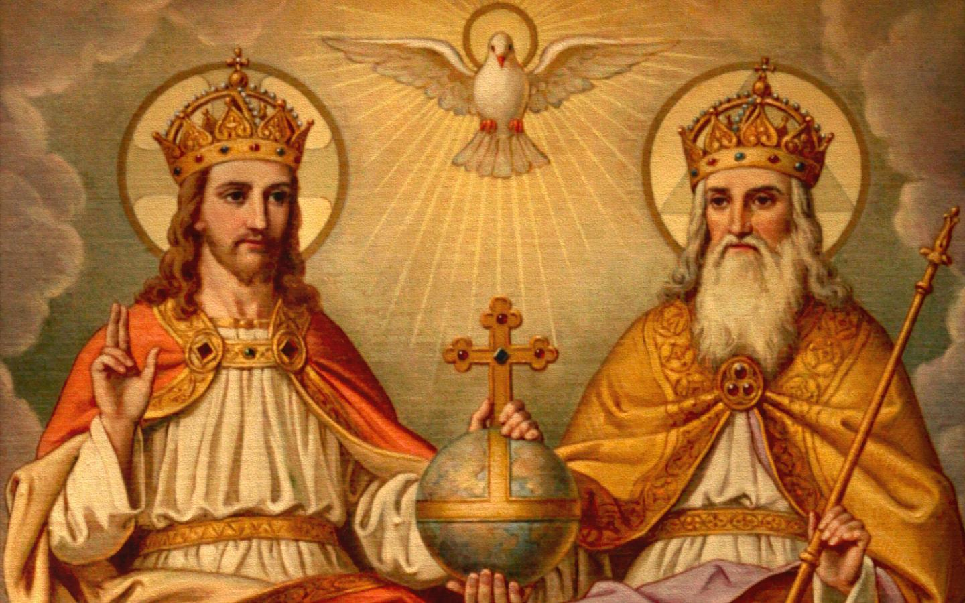
The doctrine of the Trinity was officially adopted at the Council of Constantinople in AD 381

Slide 3
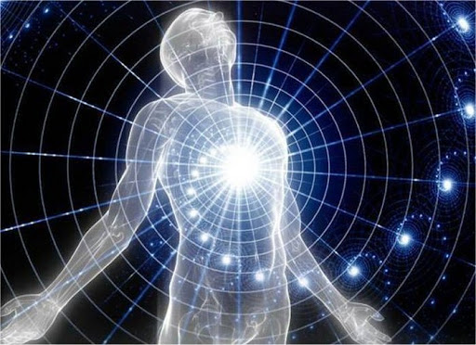
What is a Soul?
What is a Spirit?

Slide 4
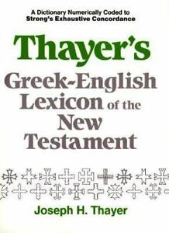
Thayer’s Definition of pneuma (Strong’s G4151)
1) the third person of the triune God, the Holy Spirit, coequal, coeternal with the Father and the Son
1a) sometimes referred to in a way which emphasises his personality and character (the \\Holy\\ Spirit)
1b) sometimes referred to in a way which emphasises his work and power (the Spirit of \\Truth\\)
1c) never referred to as a depersonalised force
2) the spirit, i.e. the vital principal by which the body is animated …

Slide 5
 | Hebrew Words | Greek Words
Spirit (the Spark OF LIFE) | rûach (roo’-akh) Strong’s H7307—n. wind; by resemblance breath. From H7306—v. to blow, that is, breathe. | pneuma (pnyoo’-mah) Strong’s G4151—n. a current of air, that is, breath (blast) or a breeze. From G4154—v. to breathe hard, to blow.
Soul (Sentience) | nephesh (neh'-fesh) Strong’s H5315—n. properly a breathing creature, that is, animal or (abstractly) vitality. From H5314—v. to breathe. | psuchē (psoo-khay') Strong’s G5590—n. breath, that is, (by implication) spirit. From G5594—v. to breathe.

Slide 6
The Scriptures recognize man as composed of two elements, body and spirit. These two produce soul, sentient being, intelligence, the man himself, the being, or soul. The term “body” applies merely to the physical organism. It neither relates to the life which animates it, nor to the sentient being which is the result of animation. … (E308.1)

Slide 7
BODY + SPIRIT = SOUL

Slide 8
BODY + SPIRIT = SOUL
or
PHYSICAL STRUCTURE + BREATH OF LIFE = A SENTIENT BEING

Slide 9
BODY + SPIRIT = SOUL
or
PHYSICAL STRUCTURE + BREATH OF LIFE = A SENTIENT BEING
And the LORD God formed man of the dust of the ground [the body was formed from earthly elements], and breathed into his nostrils the breath of life [the spirit of life]; and man became a living soul [a sentient being]. — Genesis 2:7 KJV

Slide 10
For as the body [the form] without the spirit [the breath of life] is dead [without life, without sentience], so faith without works is dead also. — James 2:26 KJV

Slide 11
For as the body [the form] without the spirit [the breath of life] is dead [without life, without sentience], so faith without works is dead also. — James 2:26 KJV
THE BODY – THE BREATH OF LIFE = NO SENTIENCE

Slide 12
For as the body [the form] without the spirit [the breath of life] is dead [without life, without sentience], so faith without works is dead also. — James 2:26 KJV
THE BODY – THE BREATH OF LIFE = NO SENTIENCE
Then shall the dust [the body, the form] return to the earth as it was: and the spirit [the breath of life] shall return unto God who gave it. — Ecclesiastes 12:7 KJV

Slide 13
And God said, Let the waters bring forth abundantly the moving creature that hath life [Strong’s H5315, nephesh, a soul] … — Genesis 1:20 KJV

Slide 14
And God said, Let the waters bring forth abundantly the moving creature that hath life [Strong’s H5315, nephesh, a soul] … — Genesis 1:20 KJV
For that which befalleth the sons of men befalleth beasts; even one thing befalleth them: as the one dieth, so dieth the other; yea, they have all one breath [Strong’s H7307, ruach, the spirit of life]; so that a man hath no preeminence above a beast: for all is vanity. — Ecclesiastes 3:19 KJV

Slide 15
… Man's superiority over the beast, according to the account given in Genesis, consists not in his having a different kind of breath or spirit, but in his having a higher form, a superior body, a finer organism—endowed with a brain organism which enables him to reason upon planes far above and beyond the intelligence of the lower animals, the brute creation. We find that it is in these respects that man was created a fleshly likeness of his Creator, who is a spirit being. John 4:24 (E310.1)

Slide 16
How Translated in the King James Version
Hebrew — Strong’s H7307, rûach
spirit (227)
wind (82)
breath (27)
winds (11)
mind (6)
side (5)
spirits (5)
blast (4)
vain (2)
air (1)
anger (1)
cool (1)
courage (1)
quarters (1)
sides (1)
spiritual (1)
tempest (1)
whirlwind (1)
windy (1)
Greek — Strong’s G4151, pneuma
spirit (257)
ghost (92)
spirits (32)
life (1)
spiritual (1)
spiritually (1)
wind (1)

Slide 17
Some of the ways ruach and pneuma are used in the Bible
When used in connection with God, it signifies that he is powerful but invisible;
When used in reference to God's influence and operation, it implies that these are accomplished by an invisible power.
It is applied to human mind because it is a power that is invisible and intangible;
It is also applied to words, which are also invisible, yet powerful;
It is applied to life because it is an invisible power or quality.

Slide 18
The Scripture speak of:
the spirit of our minds—the invisible power of the mind;
the spirit of a man—a man's mental powers and will;
the spirit of life—the power of living, which actuates all creation;
the Spirit of God—the power or influence which God exerts;
the spirit of wisdom—a wise mind;
the spirit of truth—the influence or power exerted by the truth;
the spirit of love—a mind or disposition actuated by love;
the spirit of evil and of malice—a mind actuated by maliciousness;
the spirit of the world—the influence or power which the world exerts.

Slide 19
And the earth was without form, and void; and darkness was upon the face of the deep. And the Spirit of God moved upon the face of the waters. — Genesis 1:2 KJV

Slide 20
And the earth was without form, and void; and darkness was upon the face of the deep. And the Spirit of God moved upon the face of the waters. — Genesis 1:2 KJV
And the LORD spake unto Moses, saying, See, I have called by name Bezaleel the son of Uri, the son of Hur, of the tribe of Judah: And I have filled him with the spirit of God, in wisdom, and in understanding, and in knowledge, and in all manner of workmanship, — Exodus 31:1-3 KJV

Slide 21
And the earth was without form, and void; and darkness was upon the face of the deep. And the Spirit of God moved upon the face of the waters. — Genesis 1:2 KJV
And the LORD spake unto Moses, saying, See, I have called by name Bezaleel the son of Uri, the son of Hur, of the tribe of Judah: And I have filled him with the spirit of God, in wisdom, and in understanding, and in knowledge, and in all manner of workmanship, — Exodus 31:1-3 KJV
And the Spirit of the LORD fell upon me, and said unto me, Speak; Thus saith the LORD; Thus have ye said, O house of Israel: for I know the things that come into your mind, every one of them. — Ezekiel 11:5 KJV

Slide 22
How The Holy Spirit Operates in the Gospel Age
Explanatory rather than mechanical.
Appeals to the understanding of the mind and the willingness of the heart.
Has two different aspects to its operation:
(1) the begettal of embryo New Creatures to a new nature, and
(2) the growth and development of those New Creatures.

Slide 23
Therefore will I divide him a portion with the great, and he shall divide the spoil with the strong; because he hath poured out his soul unto death: and he was numbered with the transgressors; and he bare the sin of many, and made intercession for the transgressors. — Isaiah 53:12 KJV

Slide 24
Therefore will I divide him a portion with the great, and he shall divide the spoil with the strong; because he hath poured out his soul unto death: and he was numbered with the transgressors; and he bare the sin of many, and made intercession for the transgressors. — Isaiah 53:12 KJV
Who now rejoice in my sufferings for you, and fill up that which is behind of the afflictions of Christ in my flesh for his body's sake, which is the church: — Colossians 1:24 KJV

Slide 25
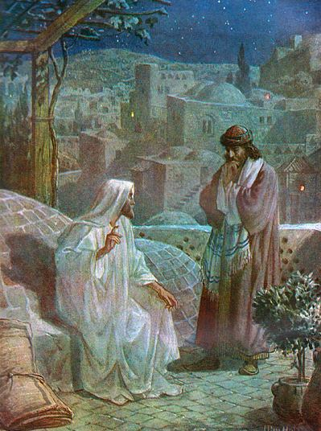
Jesus answered and said unto him, Verily, verily, I say unto thee, Except a man be born again, he cannot see the kingdom of God. Nicodemus saith unto him, How can a man be born when he is old? can he enter the second time into his mother's womb, and be born? Jesus answered, Verily, verily, I say unto thee, Except a man be born of water and of the Spirit, he cannot enter into the kingdom of God. That which is born of the flesh is flesh; and that which is born of the Spirit is spirit. — John 3:3-6 KJV

Slide 26
But ye are not in the flesh, but in the Spirit, if so be that the Spirit of God dwell in you. Now if any man have not the Spirit of Christ, he is none of his. — Romans 8:9 KJV

Slide 27
But ye are not in the flesh, but in the Spirit, if so be that the Spirit of God dwell in you. Now if any man have not the Spirit of Christ, he is none of his. — Romans 8:9 KJV
Therefore if any man be in Christ, he is a new creature: old things are passed away; behold, all things are become new. — 2 Corinthians 5:17 KJV

Slide 28
But ye are not in the flesh, but in the Spirit, if so be that the Spirit of God dwell in you. Now if any man have not the Spirit of Christ, he is none of his. — Romans 8:9 KJV
Therefore if any man be in Christ, he is a new creature: old things are passed away; behold, all things are become new. — 2 Corinthians 5:17 KJV
Know ye not, that so many of us as were baptized into Jesus Christ were baptized into his death? — Romans 6:3 KJV

Slide 29
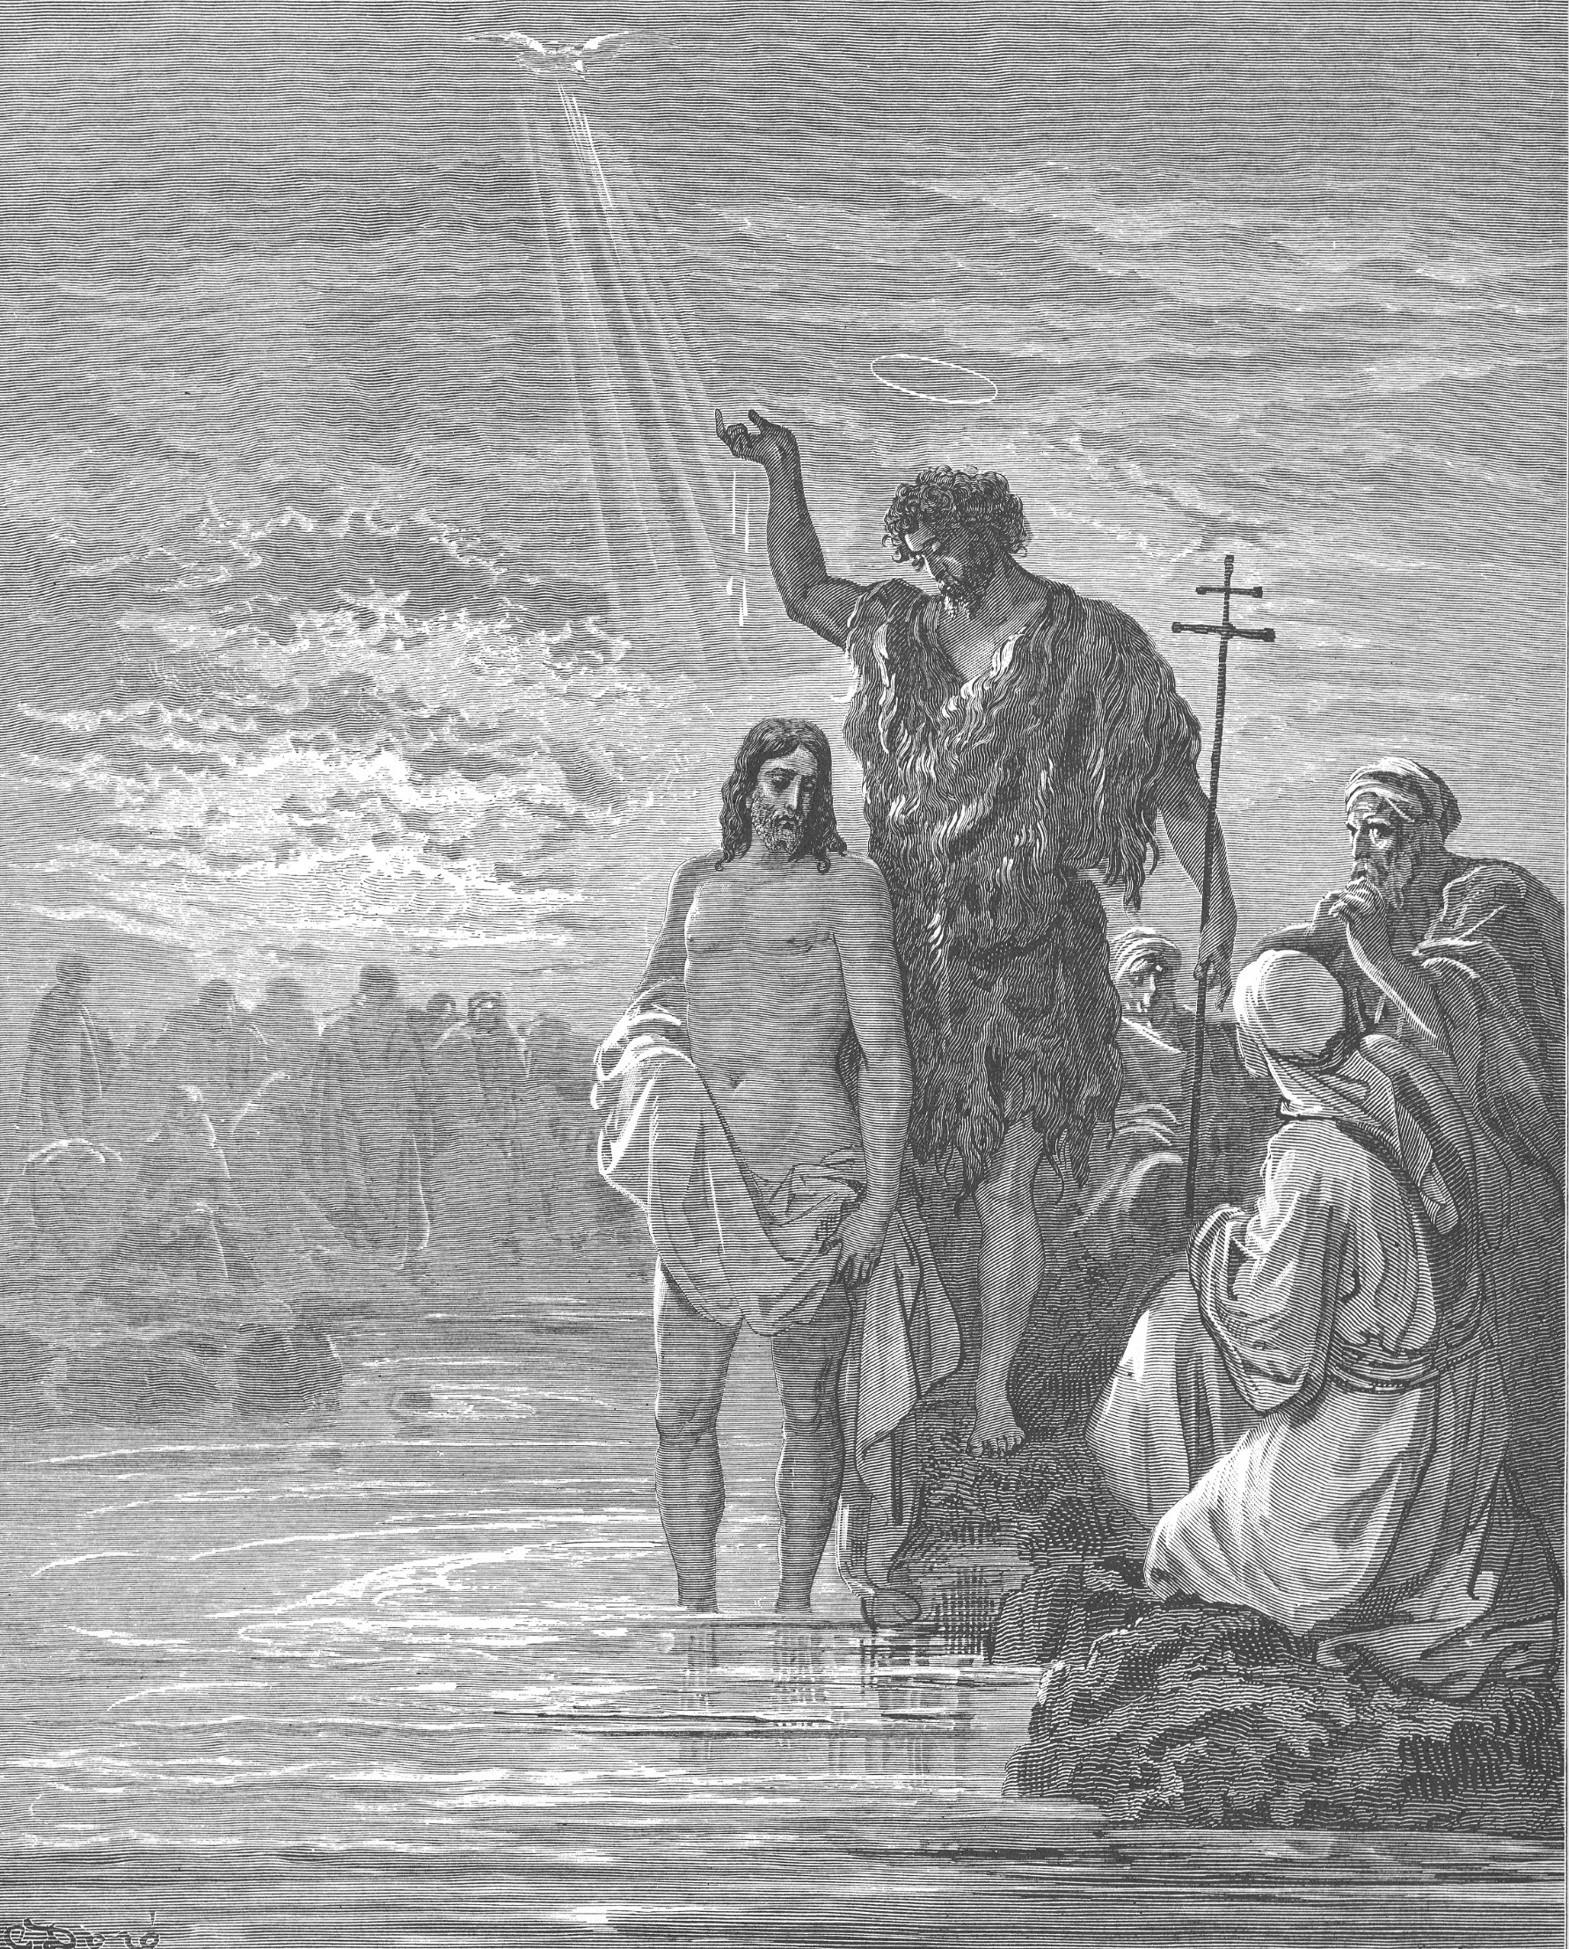
And I knew him not: but he that sent me to baptize with water, the same said unto me, Upon whom thou shalt see the Spirit descending, and remaining on him, the same is he which baptizeth with the Holy Ghost. — John 1:33 KJV

Slide 30
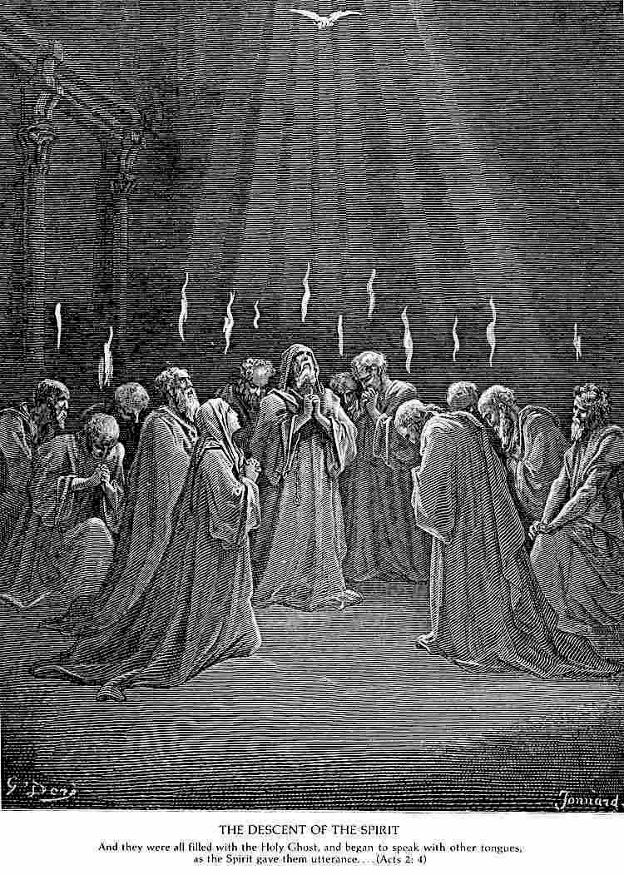
Therefore being by the right hand of God exalted, and having received of the Father the promise of the Holy [Spirit], he [Jesus] hath shed forth this, which ye now see and hear. — Acts 2:32-33 KJV
It is like the precious ointment upon the head, that ran down upon the beard, even Aaron's beard: that went down to the skirts of his garments; — Psalms 133:2 KJV

Slide 31
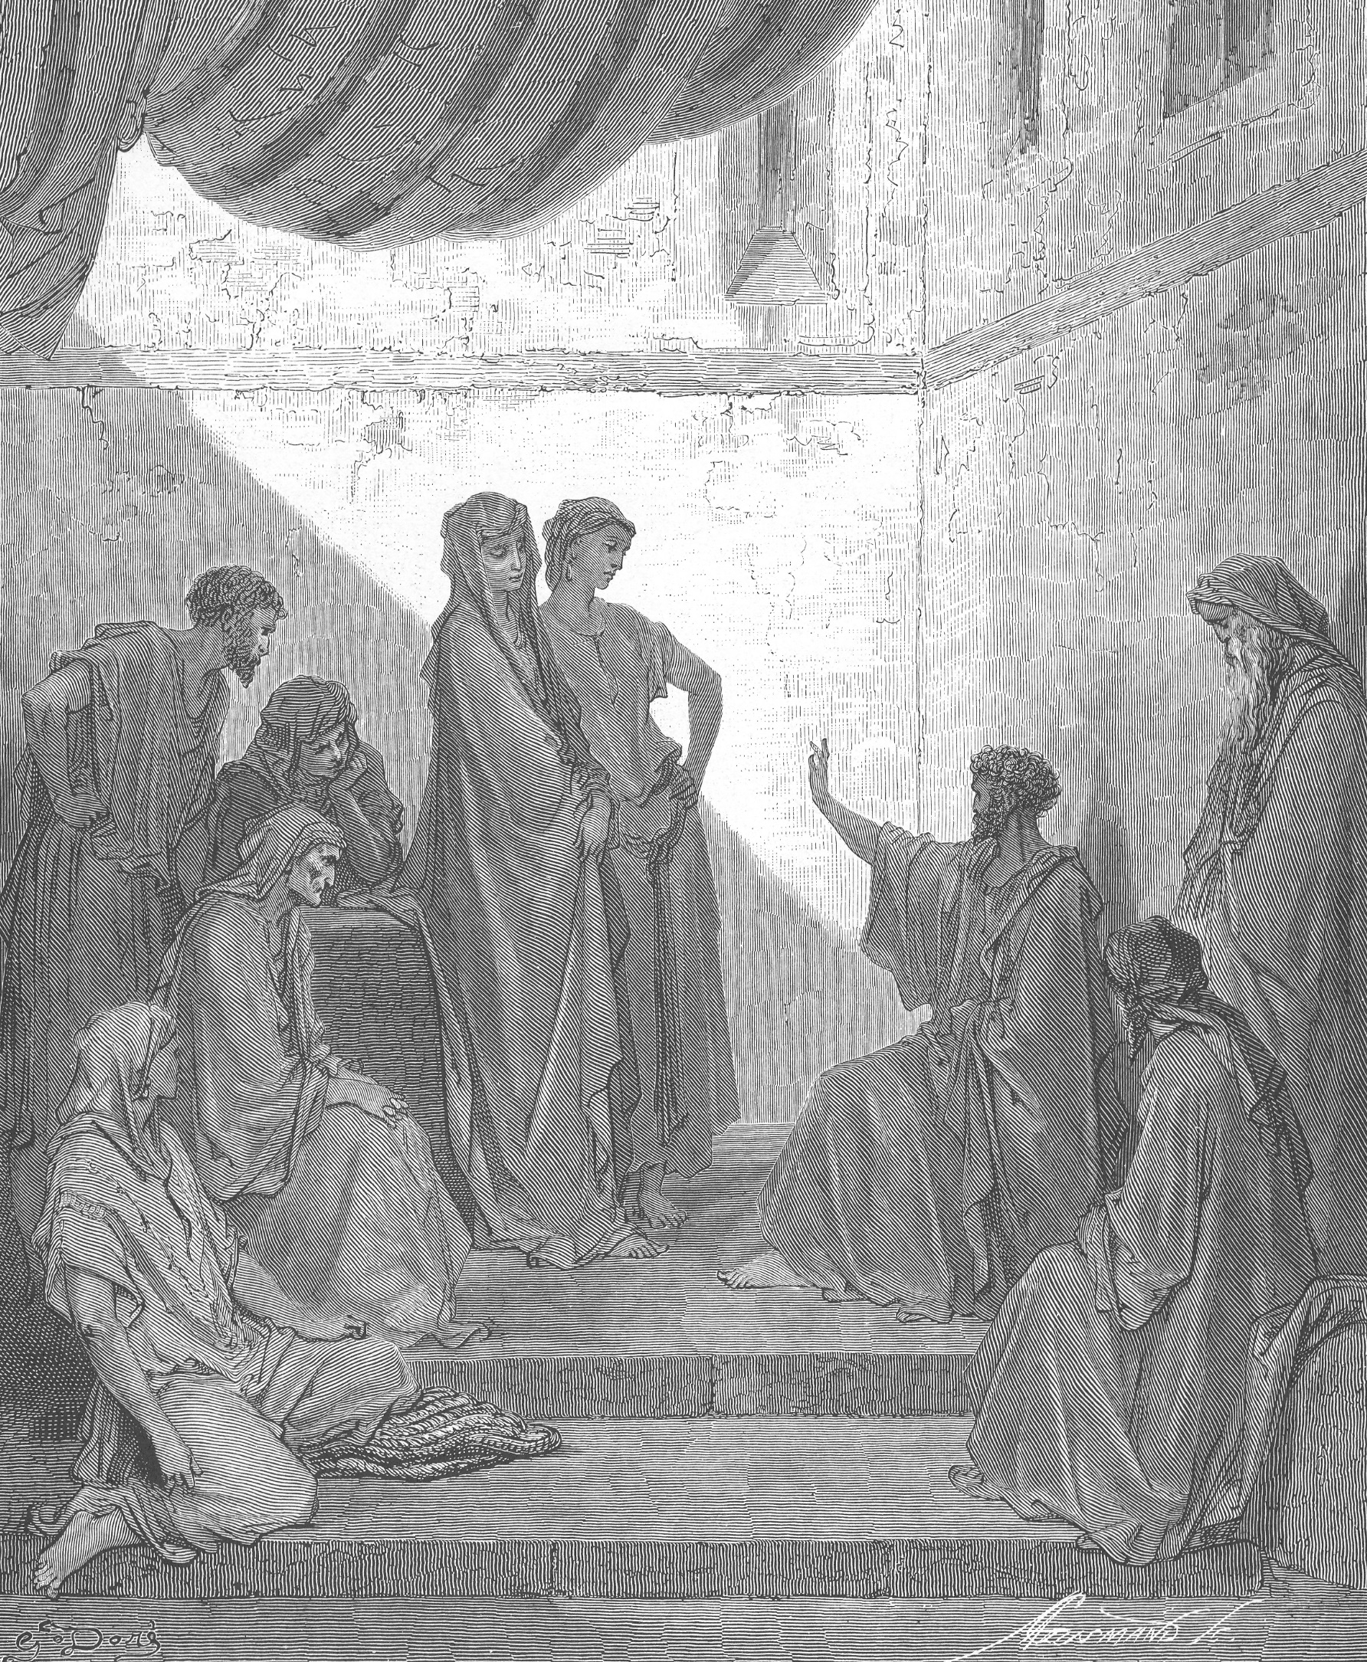
While Peter yet spake these words, the Holy Ghost fell on all them which heard the word. And they of the circumcision which believed were astonished, as many as came with Peter, because that on the Gentiles also was poured out the gift of the Holy Ghost. — Acts 10:44-45 KJV

Slide 32
There is one body, and one Spirit, even as ye are called in one hope of your calling; One Lord, one faith, one baptism, — Ephesians 4:4-5 KJV

Slide 33
The Spirit itself beareth witness with our spirit, that we are the children of God: — Romans 8:16 KJV

Slide 34
The Spirit itself beareth witness with our spirit, that we are the children of God: — Romans 8:16 KJV
Now he which stablisheth us with you in Christ, and hath anointed us, is God; Who hath also sealed us, and given the earnest of the Spirit in our hearts. — 2 Corinthians 1:21-22 KJV

Slide 35
In whom ye also trusted, after that ye heard the word of truth, the gospel of your salvation: in whom also after that ye believed, ye were sealed with that holy Spirit of promise, Which is the earnest of our inheritance until the redemption of the purchased possession, unto the praise of his glory. — Ephesians 1:13-14 KJV

Slide 36
Are
Feelings
a witness of God’s holy Spirit in us?

Slide 37
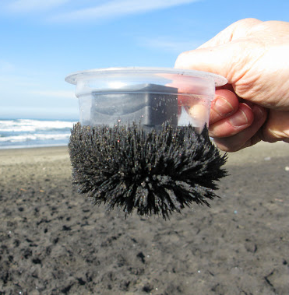
Drawn to God

Slide 38
But without faith it is impossible to please him: for he that cometh to God must believe that he is, and that he is a rewarder of them that diligently seek him. — Hebrews 11:6 KJV.

Slide 39
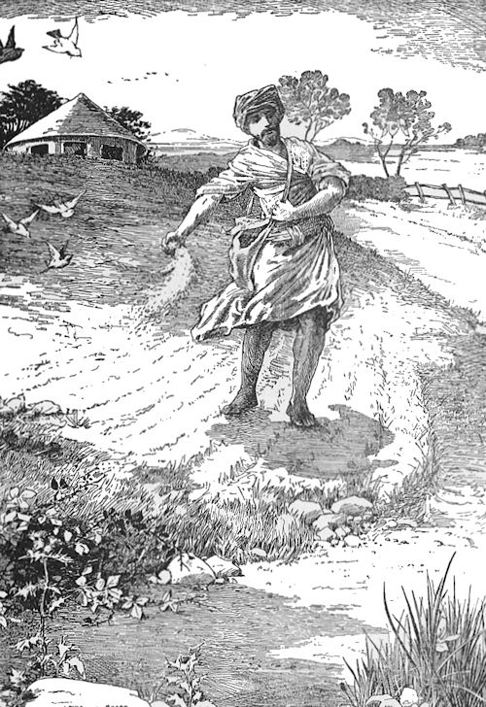
… Behold, a sower went forth to sow; And when he sowed, some seeds fell by the way side, and the fowls came and devoured them up: Some fell upon stony places, where they had not much earth: and forthwith they sprung up, because they had no deepness of earth: And when the sun was up, they were scorched; and because they had no root, they withered away. And some fell among thorns; and the thorns sprung up, and choked them: But other fell into good ground, and brought forth fruit, some an hundredfold, some sixtyfold, some thirtyfold. — Matthew 13:3-8 KJV

Slide 40
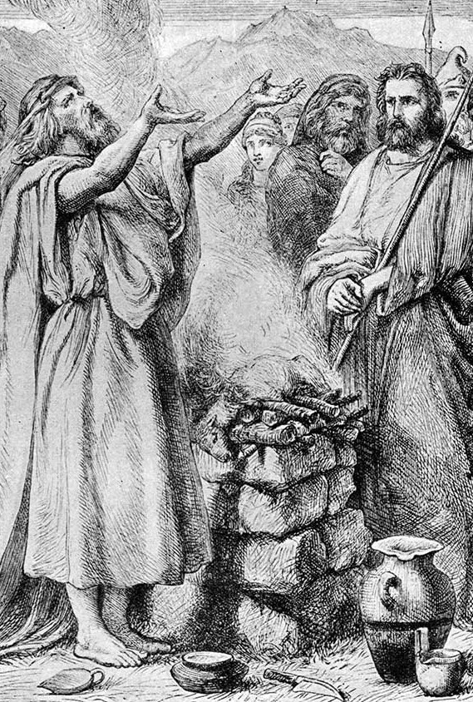
I beseech you therefore, brethren, by the mercies of God, that ye present your bodies a living sacrifice, holy, acceptable unto God, which is your reasonable service. — Romans 12:1 KJV

Slide 41
I beseech you therefore, brethren, by the mercies of God, that ye present your bodies a living sacrifice, holy, acceptable unto God, which is your reasonable service. — Romans 12:1 KJV
And he that keepeth his commandments dwelleth in him, and he in him. And hereby we know that he abideth in us, by the Spirit which he hath given us. — 1 John 3:24 KJV

Slide 42
I beseech you therefore, brethren, by the mercies of God, that ye present your bodies a living sacrifice, holy, acceptable unto God, which is your reasonable service. — Romans 12:1 KJV
And he that keepeth his commandments dwelleth in him, and he in him. And hereby we know that he abideth in us, by the Spirit which he hath given us. — 1 John 3:24 KJV
The Spirit itself beareth witness with our spirit, that we are the children of God: — Romans 8:16 KJV

Slide 43
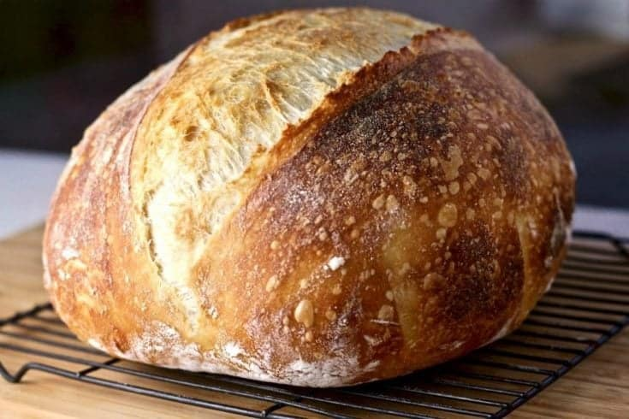
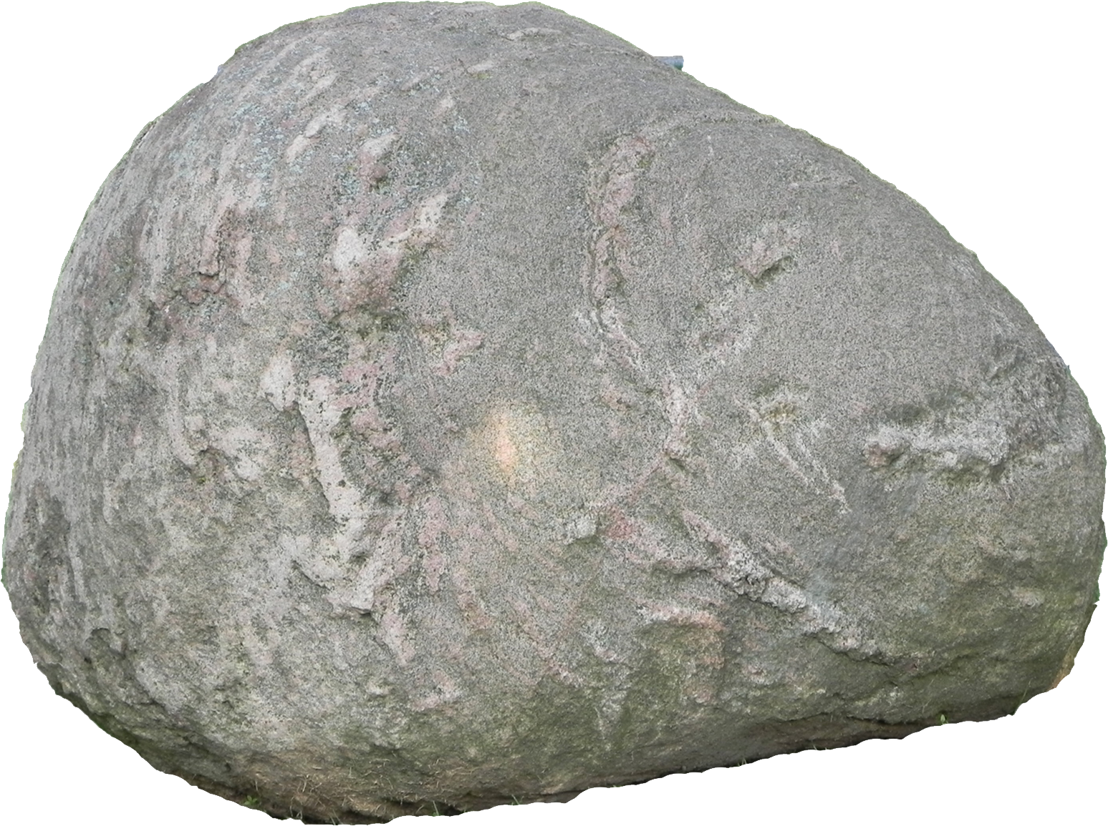
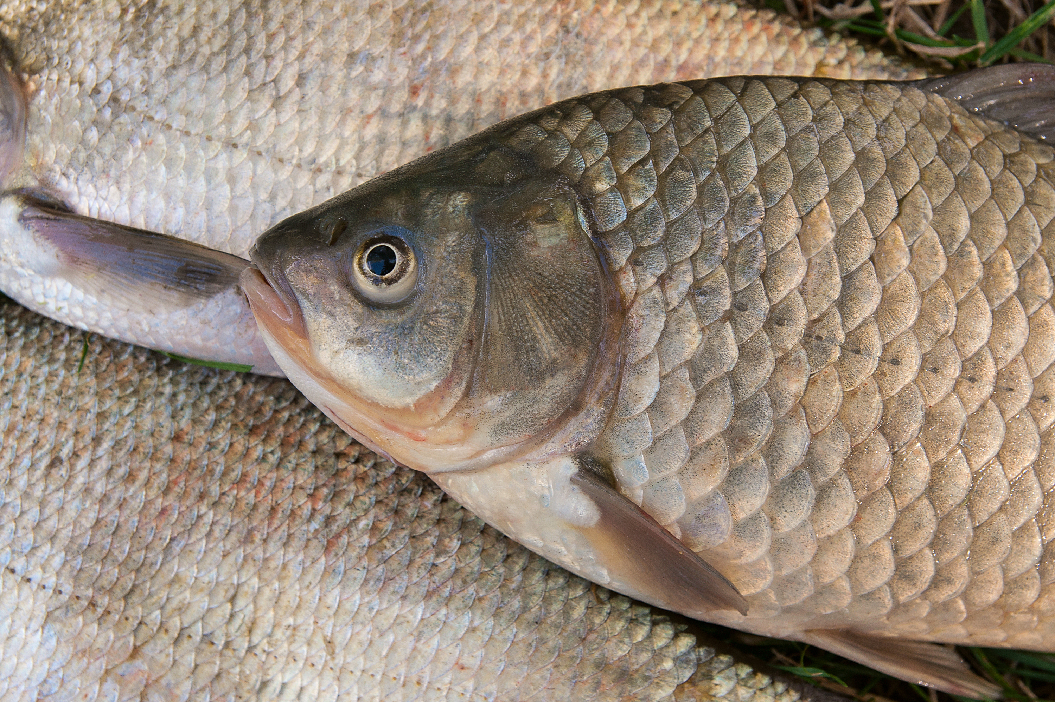
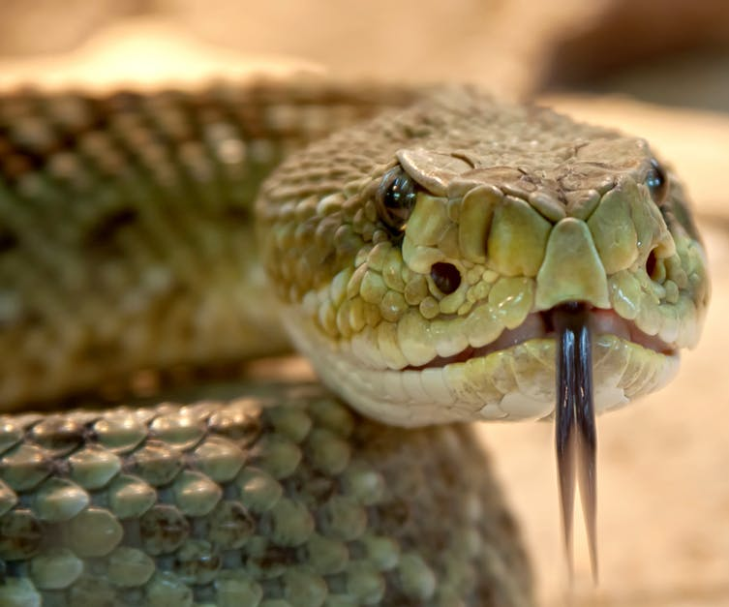
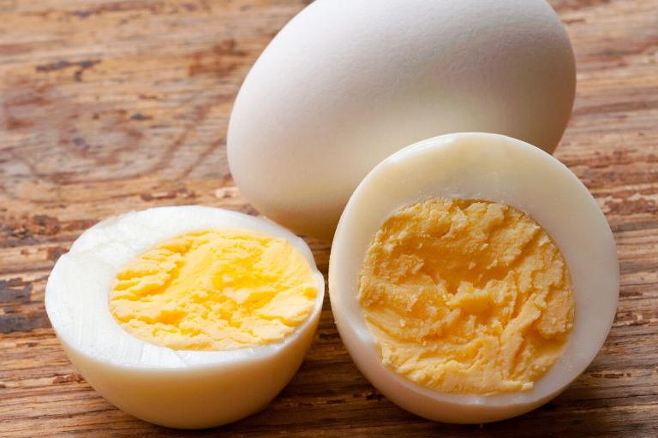
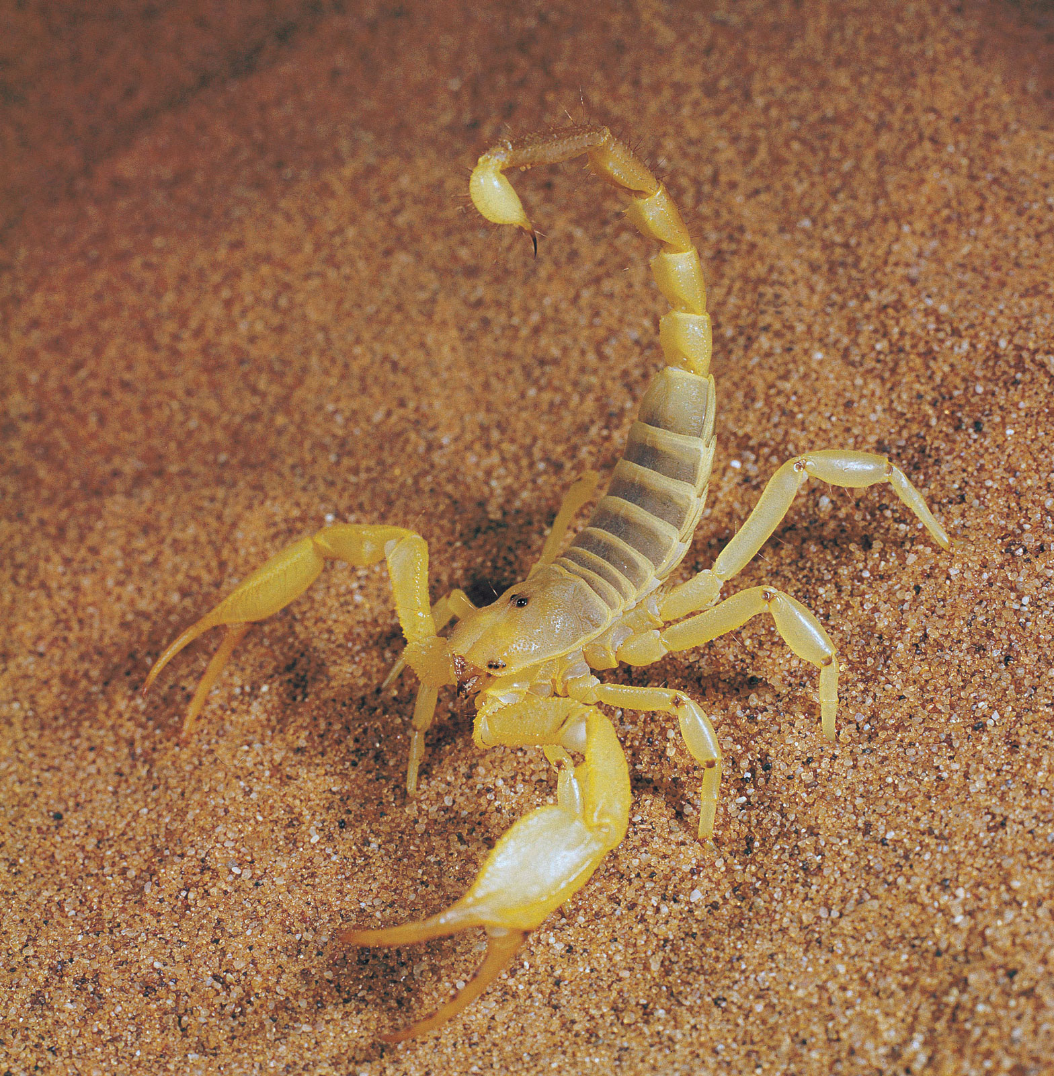
If a son shall ask bread of any of you that is a father, will he give him a stone? or if he ask a fish, will he for a fish give him a serpent? Or if he shall ask an egg, will he offer him a scorpion? If ye then, being evil, know how to give good gifts unto your children: how much more shall your heavenly Father give the Holy Spirit to them that ask him? — Luke 11:11-13 KJV

Slide 44
For by one Spirit are we all baptized into one body, whether we be Jews or Gentiles, whether we be bond or free; and have been all made to drink into one Spirit. — 1 Corinthians 12:13 KJV

Slide 45
And be not drunk with wine, wherein is excess; but be filled with the Spirit; — Ephesians 5:18 KJV

Slide 46
And be not drunk with wine, wherein is excess; but be filled with the Spirit; — Ephesians 5:18 KJV
… He bids us seek for and ask for this, as the great, supreme blessing … (E222.2)

Slide 47
If ye abide in me, and my words abide in you, ye shall ask what ye will, and it shall be done unto you. — John 15:7 KJV

Slide 48
For he whom God hath sent speaketh the words of God: for God giveth not the Spirit by measure unto him. — John 3:34 KJV

Slide 49
… The holy Spirit is the spirit of love—to God and to man. It cannot be given to us under present conditions except gradually, as the old selfish, wrong spirit is deposed from our hearts. This, therefore, must be continually our prayer to the end of life's journey, that we might be filled with the Spirit of the Lord … (R3665.2)

Slide 50
And be not conformed to this world: but be ye transformed by the renewing of your mind, that ye may prove what is that good, and acceptable, and perfect, will of God. — Romans 12:2 KJV

Slide 51
The promise of being “filled with the Spirit “ or mind of God is not to those who merely possess the Word of God, nor to those who merely read the Word of God, but is to those who search it earnestly, seeking to understand it; and who understanding it are willing, nay, anxious to obey it. If we would be filled with the Spirit of God, we must drink deeply of the fountain of Truth—his Word. … (E205.1)

Slide 52
But the Comforter [Strong’s G3875, paraklētos], which is the Holy Ghost, whom the Father will send in my name, he shall teach you all things, and bring all things to your remembrance, whatsoever I have said unto you. — John 14:26 KJV

Slide 53
But the Comforter [Strong’s G3875, paraklētos], which is the Holy Ghost, whom the Father will send in my name, he shall teach you all things, and bring all things to your remembrance, whatsoever I have said unto you. — John 14:26 KJV
My little children, these things write I unto you,
that ye sin not. And if any man sin, we have an advocate
[Strong’s G3875, paraklētos] with the Father,
Jesus Christ the righteous: — 1 John 2:1 KJV

Slide 54
It is not the Truth, but the spirit of the Truth, it is not the Word of God, although it is in harmony with the Word; it is not holiness, yet it is in full accord with holiness. It is the spirit, the disposition, which is associated with a sound mind, with holiness, with Truth and with the Word of God. (R5227.11)

Slide 55
As newborn babes, desire the sincere milk of the word, that ye may grow thereby: — 1 Peter 2:2 KJV

Slide 56
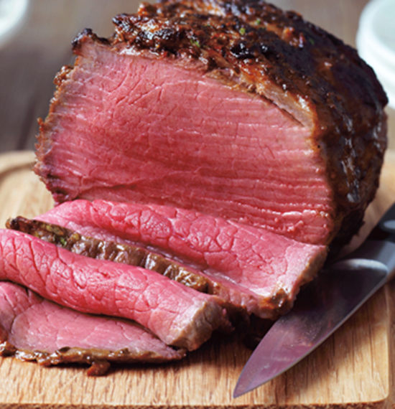
As newborn babes, desire the sincere milk of the word, that ye may grow thereby: — 1 Peter 2:2 KJV
For every one that useth milk is unskilful in the word of righteousness: for he is a babe. But strong meat belongeth to them that are of full age, even those who by reason of use have their senses exercised to discern both good and evil. — Hebrews 5:13-14 KJV

Slide 57
But grow in grace, and in the knowledge of our Lord and Saviour Jesus Christ. To him be glory both now and for ever. Amen. — 2 Peter 3:18 KJV

Slide 58
But grow in grace, and in the knowledge of our Lord and Saviour Jesus Christ. To him be glory both now and for ever. Amen. — 2 Peter 3:18 KJV
But whoever keeps His word, truly the love of God is perfected in him. By this we know that we are in Him. — 1 John 2:5 EMTV

Slide 59
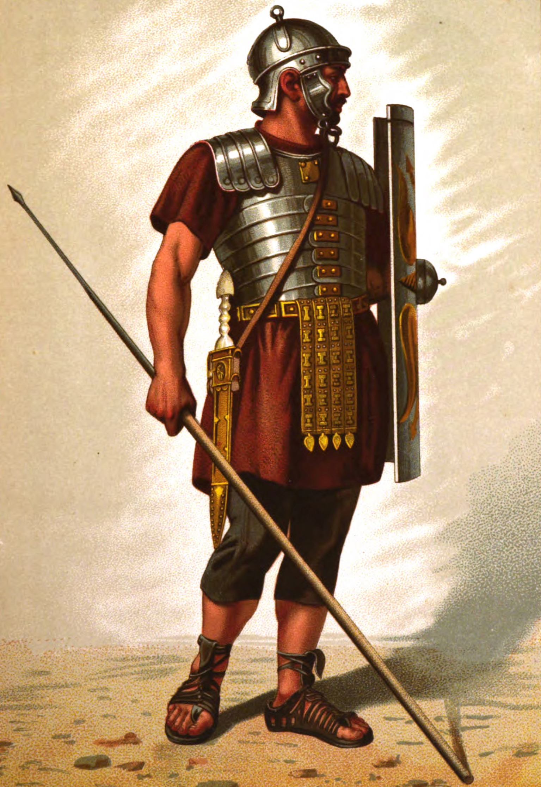
We know that whosoever is born of God sinneth not; but he that is begotten of God keepeth himself, and that wicked one toucheth him not. — 1 John 5:18 KJV

Slide 60
Wherefore come out from among them, and be ye separate, saith the Lord, and touch not the unclean thing; and I will receive you, — 2 Corinthians 6:17 KJV

Slide 61
Wherefore come out from among them, and be ye separate, saith the Lord, and touch not the unclean thing; and I will receive you, — 2 Corinthians 6:17 KJV
If ye were of the world, the world would love his own: but because ye are not of the world, but I have chosen you out of the world, therefore the world hateth you. — John 15:19

Slide 62
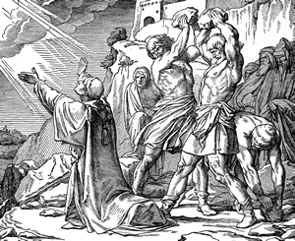
Yea, and all that will live godly in Christ Jesus shall suffer persecution. — 2 Timothy 3:12 KJV

Slide 63
Yea, and all that will live godly in Christ Jesus shall suffer persecution. — 2 Timothy 3:12 KJV
If ye be reproached for the name of Christ, happy are ye; for the spirit of glory and of God resteth upon you: on their part he is evil spoken of, but on your part he is glorified. — 1 Peter 4:14 KJV

Slide 64
Yea, and all that will live godly in Christ Jesus shall suffer persecution. — 2 Timothy 3:12 KJV
If ye be reproached for the name of Christ, happy are ye; for the spirit of glory and of God resteth upon you: on their part he is evil spoken of, but on your part he is glorified. — 1 Peter 4:14 KJV
Yet if any man suffer as a Christian, let him not be ashamed; but let him glorify God on this behalf. — 1 Peter 4:16 KJV

Slide 65
Blessed are you when men shall hate you, and when they shall cut you off, and when they shall reproach you and shall cast out your name as evil, for the sake of the Son of Man. — Luke 6:22 MKJV

Slide 66
I am the Vine—the True Vine,
and my Father is the vine-dresser.
Every branch in me—if it bears no fruit,
He takes away; and every branch that bears fruit
He prunes, that it may bear more fruit.
— John 15:1-2 Weymouth

Slide 67
I am the Vine—the True Vine,
and my Father is the vine-dresser.
Every branch in me—if it bears no fruit,
He takes away; and every branch that bears fruit
He prunes, that it may bear more fruit.
— John 15:1-2 Weymouth
… to have these experiences, after having become identified with the “Vine,” is to have the witness of the Spirit that we are still in the “Vine,” and still recognized as “branches” of it—still under our Lord's care and discipline. … (E230.2)

Slide 68
… “My sons, do not disdain the discipline [Strong’s G3809] of the Lord nor lose heart when he reproves you; For whom the Lord loves, he disciplines [Strong’s G3811]; he scourges every son he receives.” Endure your trials as the discipline [Strong’s G3809] of God, who deals with you as sons. For what son is there whom his father does not discipline [Strong’s G3811]? If you do not know the discipline of sons, you are not sons but bastards. — Hebrews 12:5-8 NAB
Strong’s G3811, paideuō (pahee-dyoo'-o). From G3816; to train up a child, that is, educate, or (by implication) discipline (by punishment): - chasten (-ise), instruct, learn, teach. Total KJV occurrences: 13
Strong’s G3809, paideia (pahee-di'-ah). From G3811; tutorage, that is, education or training; by implication disciplinary correction: - chastening, chastisement, instruction, nurture. Total KJV occurrences: 6

Slide 69
Ordinarily the word chastisement is used to signify correction for wrongdoing. But in the Bible, it is especially used to convey the thought of discipline or instruction in righteousness. Sometimes we use it in this way in the ordinary affairs of life. If we sin, we receive punishment indeed. But those who are trying to do right are continually receiving discipline of the Lord. There is a purpose in this training, or chastisement. The Church is learning how to build character pleasing in the Father's sight, to be well qualified for particular service; and discipline is the means employed for that instruction. (R5147.3)

Slide 70
As our Lord was chastened for our transgressions, not his own, when he bore the sins of many, so his followers in many respects suffer, not for their own wrongdoing, but by reason of the wrongdoing of others, for they are called as the Apostle declares, to “fill up that which is behind of the afflictions of Christ, for his body's sake, which is the Church.” Colossians 1:24 (E234.1)

Slide 71
For it is better, if the will of God be so, that ye suffer for well doing, than for evil doing. For Christ also hath once suffered for sins, the just for the unjust, that he might bring us to God, being put to death in the flesh, but quickened by the Spirit:
— 1 Peter 3:17-18 KJV

Slide 72
For it is better, if the will of God be so, that ye suffer for well doing, than for evil doing. For Christ also hath once suffered for sins, the just for the unjust, that he might bring us to God, being put to death in the flesh, but quickened by the Spirit:
— 1 Peter 3:17-18 KJV
For even hereunto were ye called: because Christ also suffered for us, leaving us an example, that ye should follow his steps: — 1 Peter 2:21 KJV

Slide 73
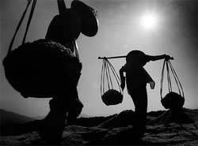
For our light affliction, which is but for a moment, worketh for us a far more exceeding and eternal weight of glory; — 2 Corinthians 4:17 KJV

Slide 74
For our light affliction, which is but for a moment, worketh for us a far more exceeding and eternal weight of glory; — 2 Corinthians 4:17 KJV
But we have this treasure in earthen vessels, that the excellency of the power may be of God, and not of us. — 2 Corinthians 4:7 KJV

Slide 75
For our light affliction, which is but for a moment, worketh for us a far more exceeding and eternal weight of glory; — 2 Corinthians 4:17 KJV
But we have this treasure in earthen vessels, that the excellency of the power may be of God, and not of us. — 2 Corinthians 4:7 KJV
Therefore we ought to give the more earnest heed to the things which we have heard, lest at any time we should let them slip. — Hebrews 2:1 KJV

Slide 76
Ye also, as lively stones, are built up a spiritual house, an holy priesthood, to offer up spiritual sacrifices, acceptable to God by Jesus Christ.— 1 Peter 2:5 KJV

Slide 77
Ye also, as lively stones, are built up a spiritual house, an holy priesthood, to offer up spiritual sacrifices, acceptable to God by Jesus Christ.— 1 Peter 2:5 KJV

Slide 78
For as many as are led by the Spirit of God, they are the sons of God. — Romans 8:14 KJV
This, then, is the guide by which we may know our true position, not only at the beginning of the race, but to the end of it, viz., if we are led by the Spirit of God—if that is the direction in which we are following, if that is what we are seeking—then we are sons of God; He owns and accepts all who have come unto Him through Christ, and who are trusting in the merit of the wedding garment, and who continue in this attitude of heart. (R3203:6)

